Slide 1

Presented By: Team Members: 1. Mukkara DivyaSree-24251A05M9 2. Komatireddy Keerthana-24241A05L9 3. P. Sai Priya Reddy-24251A05R3
G. NARAYANAMMA INSTITUTE OF TECHNOLOGY & SCIENCE
AUTONOMOUS(For Women)
Shaikpet, Hyderabad ,Telangana
DEPARTMENT OF COMPUTER SCIENCE AND ENGINEERING
Lightweight Anomaly Detection for Wearable Data Using Autoencoders
Batch No:D9
Guide: Dr. A. Sarada
Professor & Head

Slide 2
Table of Contents
Introduction
Literature Survey
Existing system
Problem Statement
Proposed system
Objectives
Methodology
Technologies
Results

Slide 3
Introduction
Background of Topic
Wearable devices such as smartwatches and fitness trackers enable continuous monitoring of physiological and activity-based data including heart rate, sleep patterns, and motion signals. These devices generate large volumes of time-series health data.
Domain Overview
The project belongs to the domain of:
Digital Health Analytics
Wearable Computing
Lightweight Deep Learning
Real-Time Anomaly Detection
Who Faces the Problem
IT employees and corporate professionals
Individuals with sedentary lifestyles
Employees exposed to stress and irregular sleep cycles
Why It Must Be Solved
Sedentary behavior increases risk of cardiovascular diseases
Circadian rhythm disruption leads to stress and burnout
Existing fitness apps do not intelligently detect abnormal patterns
Importance of the Problem
Early detection prevents long-term health complications
Supports corporate wellness programs
Enables proactive health monitoring
Need for the System
A lightweight, real-time anomaly detection system is required to:
Identify abnormal physiological patterns
Detect circadian rhythm disruptions
Operate efficiently on resource-constrained wearable devices

Slide 4
Literature Survey
S.No | Tittle of the Journal with Published Year | Authors | Method | Outcomes | Limitations
1 | Deep Learning for Wearable Health Monitoring (2023) | Zhang et al. | LSTM + Autoencoder | Improved stress detection | High computational cost
2 | Real-Time Anomaly Detection in IoT Healthcare (2022) | Kumar & Singh | Autoencoder-based anomaly detection | Efficient anomaly detection | Limited feature diversity
3 | Circadian Rhythm Monitoring Using Wearables (2021) | Lee et al. | Time-series analysis | Identified sleep irregularities | No deep learning integration
4 | Accelerometer-Based Sedentary Detection (2020) | Smith et al. | Threshold-based classification | Accurate sedentary time detection | Not adaptive
5 | Lightweight Deep Learning Models for Edge Devices (2019) | Chen & Wang | Compact neural networks | Low computational overhead | Reduced model complexity

Slide 5
Existing system
Current System Description
Current wearable systems provide:
Step count tracking
Heart rate monitoring
Sleep duration display
How It Works
Collects raw sensor signals
Displays summary statistics
Provides basic alerts (e.g., step goals)
Technologies Used
Embedded firmware
Basic signal processing
Rule-based threshold systems
Limitations / Challenges
No intelligent anomaly detection
No circadian disruption analysis
No personalized risk scoring
High computational cost for complex models

Slide 6
Problem statement
Wearable devices generate continuous physiological and activity data, but existing systems fail to intelligently detect subtle abnormalities in real time. Circadian rhythm disruptions and stress-related deviations often go unnoticed due to the lack of lightweight anomaly detection models suitable for wearable environments. Therefore, the problem is to develop an efficient autoencoder-based system that can learn normal patterns and identify unusual behavioral deviations from wearable data.

Slide 7
Proposed system
Solution Idea
Develop a lightweight autoencoder model that learns normal wearable health patterns and detects abnormal behavior using reconstruction error.
How It Solves the Problem
Learns normal physiological patterns
Detects unusual deviations
Identifies circadian disruptions early
Suitable for real-time wearable deployment
Key Features
Accelerometer-based sedentary detection
Stress score computation
Recovery index calculation
Lightweight deep learning model
Smartwatch-style visualization dashboard

Slide 8
Objectives
To address the challenge of personalized circadian rhythm disruption detection using wearable data.
To develop a system that can analyze multiple physiological parameters such as heart rate, activity level, and respiratory rate together.
To build an unsupervised learning model (autoencoder) that learns normal behavior without requiring labeled data.
To detect abnormal patterns by measuring deviation from learned normal behavior using reconstruction error.
To design a lightweight and efficient solution that can work in near real-time on wearable with low computational overhead.
To provide an interactive and user-friendly dashboard for visualizing health patterns and anomalies.

Slide 9
Methodology
Flow Diagram
Data Collection → Data Preprocessing → Feature Engineering → Autoencoder Training → Reconstruction Error Calculation → Anomaly Detection → Dashboard Visualization → Performance Evaluation
Modules of Project
Data Collection Module
Preprocessing & Normalization Module
Feature Engineering Module
Lightweight Autoencoder Model Module
Anomaly Detection Module
Visualization Dashboard Module
Short Explanation
Collect wearable data (accelerometer, HR, sleep, steps)
Normalize and clean signals
Extract derived features (sedentary minutes, stress score)
Train autoencoder on normal data
Detect anomalies using reconstruction error
Display results in dashboard

Slide 10
Technologies
Python
Pandas
NumPy
Scikit-learn
TensorFlow / Keras
Plotly
Streamlit
VS code

Slide 11
Results
Outputs
Continuous reconstruction error graph (spikes = anomalies)
Automatic anomaly detection using threshold
Dashboard showing key health metrics
Manual input → instant analysis
Performance Metrics
Low training loss (~0.00237)
Stable normal error (~0.0019)
Threshold (~0.00582) for anomaly detection
~5% data detected as anomalies
Observations
Detects meaningful abnormal patterns
Learns personalized user behavior
Feature engineering improves results
Works without labeled data

Slide 12
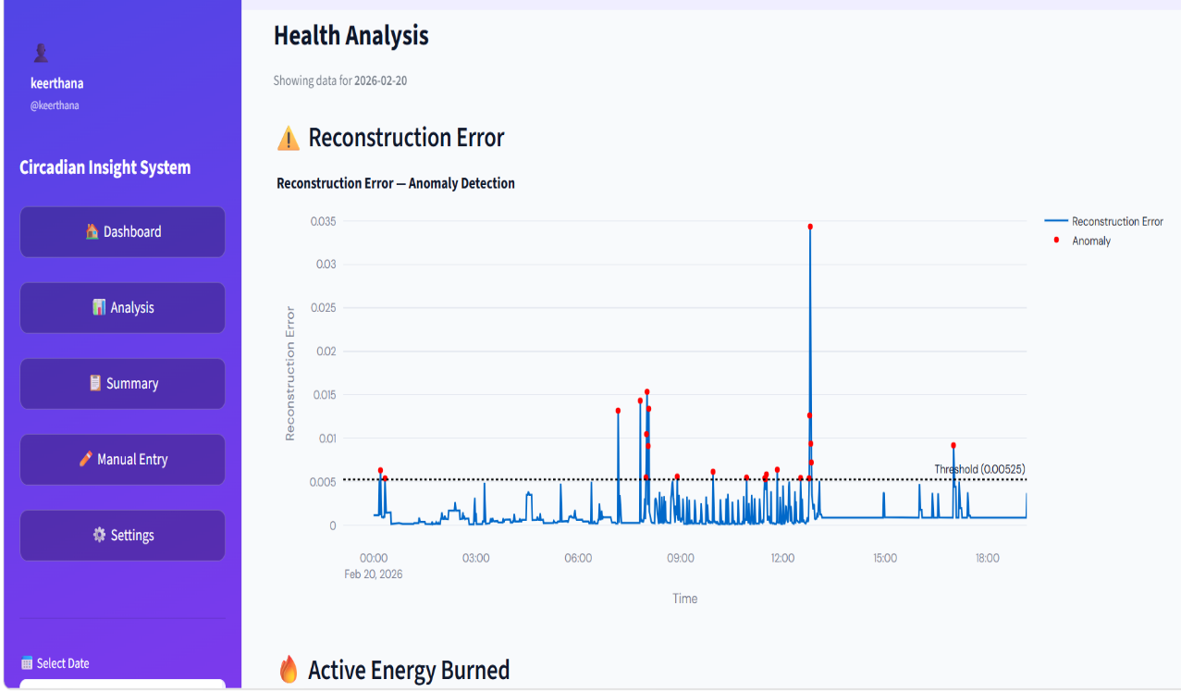
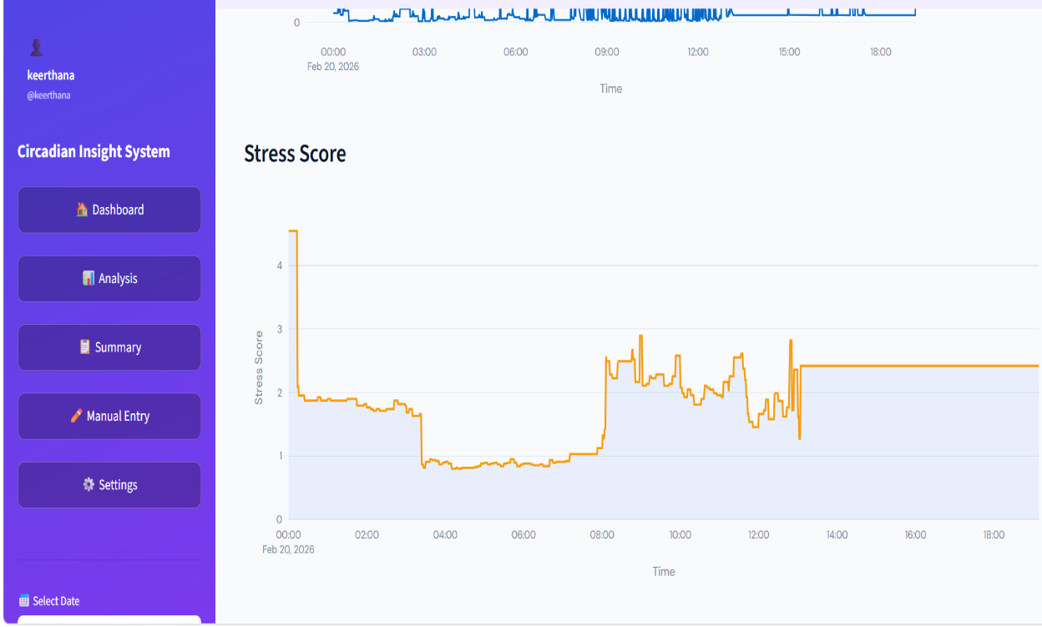
Displays reconstruction error over time to detect abnormal patterns.
Red points indicate anomalies where error exceeds the threshold.
Helps visually identify unusual health behaviour and sudden deviations.
Shows variation of stress levels throughout the day using time-series visualization.
Helps identify periods of high and low stress based on physiological signals.
Useful for understanding daily behavioural and emotional patterns.

Slide 13
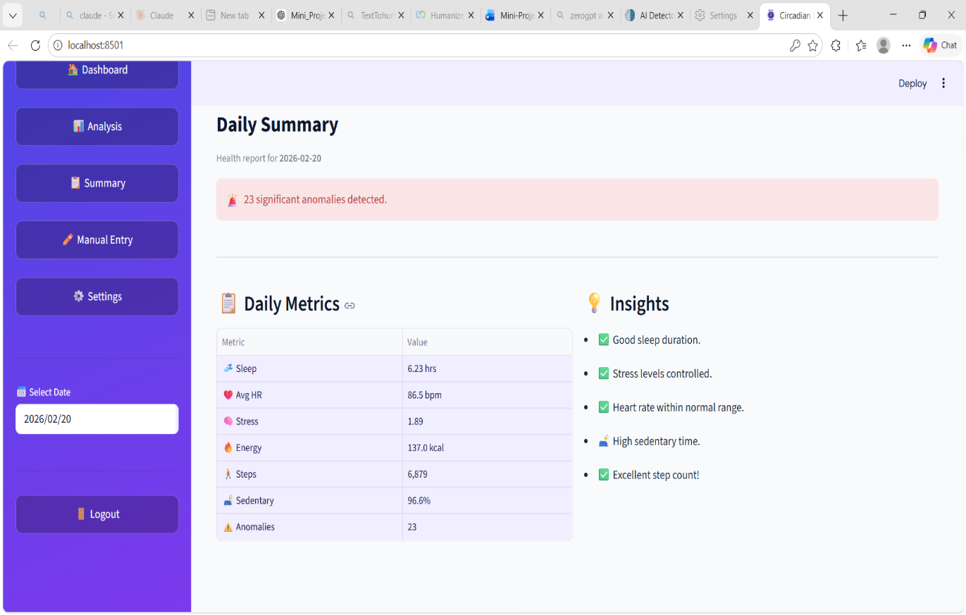
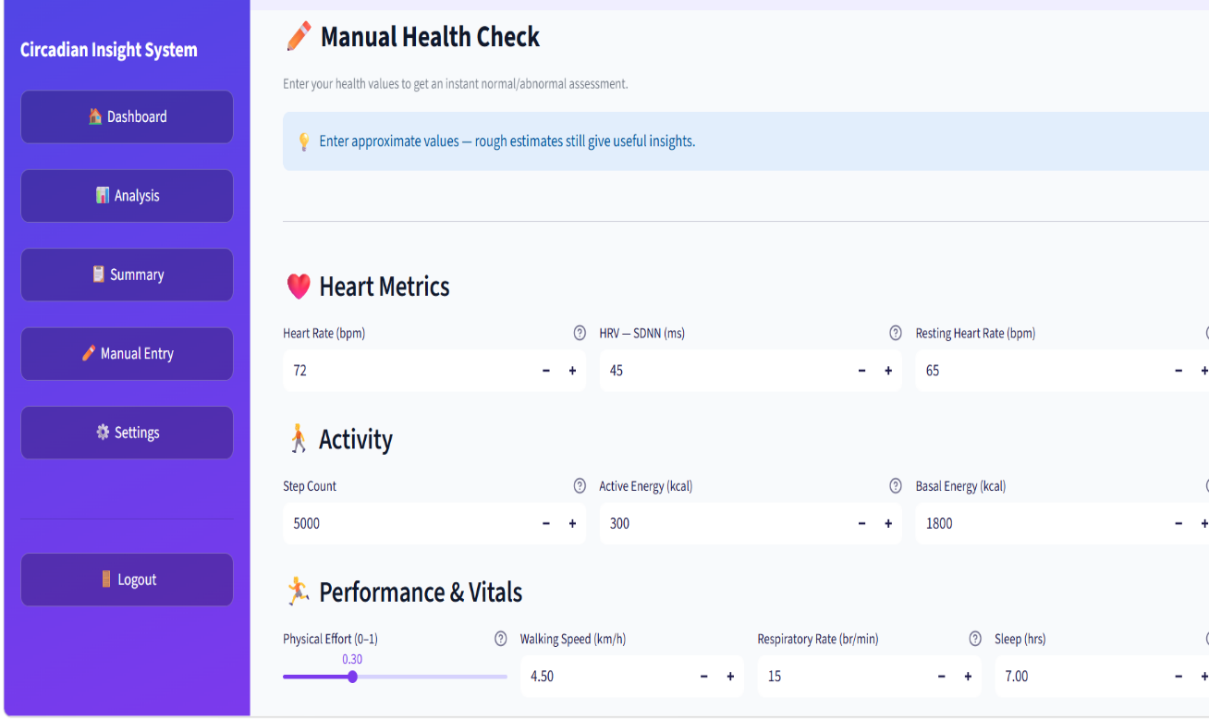
Displays key daily metrics like sleep, heart rate, stress, steps, and anomalies in a single view.
Highlights important insights such as good sleep, controlled stress, or high sedentary time.
Provides quick understanding of overall health condition without analysing raw data.
Allows users to manually enter health values when wearable data is unavailable.
Accepts inputs like heart rate, steps, energy, sleep, and respiratory rate.
Provides instant feedback to classify entered data as normal or abnormal.

Slide 14
References
Goodfellow I., Bengio Y., Courville A., Deep Learning, First Edition, MIT Press, 2016
Aggarwal C. C., Neural Networks and Deep Learning, Springer, 2018
Bishop C. M., Pattern Recognition and Machine Learning, Springer, 2006
Szeliski R., Computer Vision: Algorithms and Applications, Springer, 2011

Slide 15
Thank you

